Slide 1
Failed Banking Transaction Analysis
By gary felix a

Slide 2
Abstract
In today’s world, the transaction failures can significantly affect the customer satisfaction, revenue, and operational efficiency. This project focusses on analysing the failed bank transactions for last 7 days considering 3 cities having 5 branches each and this is done by using scalable and reliable cloud technologies provided by Google Cloud Platform(GCP).
The objective is to build a data pipeline that filters out failed transactions from raw datasets using PySpark on Dataproc, stores the filtered failed data in Cloud SQL, and then analyzes and visualizes it using BigQuery and Looker Studio. The data contains key attributes such as transaction ID, customer ID, date, status, amount, city, purposes, and payment mode.
This solution demonstrates how cloud-native tools can be leveraged to perform real-time analytics on transactional data and deliver impactful business insights.

Slide 3
PROJECT OBJECTIVE
Collecting and ingesting daily transaction data from multiple bank branches 3 cities, 5 branches each.
Then, the raw data is stored in the Google Cloud Storage(GCS) and using python code, all the 15 csv files are Cleaned, collated, into a single cleaned transaction file and filtered failed transactions records using PySpark on Dataproc.
Then, the failed transaction file is imported in the Google Cloud SQL and the data is stored in the database.
At last, Cloud SQL is connected with BigQuery which enables analysis and visualization of failed bank transaction records using Looker Studio.

Slide 4
Tech stack
Python
Spark
Google Cloud Storage
Cloud SQL
Google BigQuery
Looker Studio

Slide 5
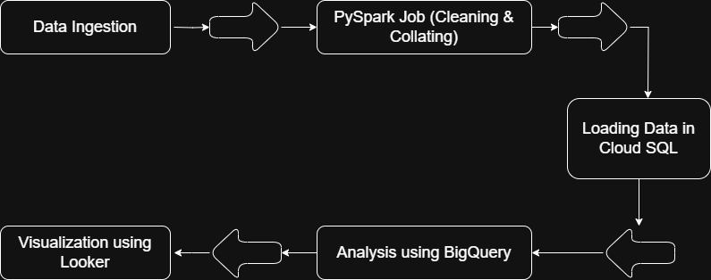
Architecture diagram

Slide 6
DATA INGESTION
In this project, the data ingestion phase involves the extraction, transformation, and loading of failed transaction records into a structured format for analysis and visualization.
The data is Ingested from multiple csv files provided by bank-branches from various cities considering 3 cities, 5 branches, and each file contains 7 days of transaction details.
The raw data is stored in the Google Cloud Storage(GCS) and using python code, all the 15 csv files are Cleaned, processed, and collated into a single cleaned transaction file using PySpark on Dataproc.
Then, the cleaned data is further processed to filter failed transaction records and saved as a csv file, which is stored in the Cloud storage.

Slide 7

Pyspark job – cleaning & filtering
Using Dataproc single node cluster, all the 15 csv files are read from the Google Cloud Storage(GCS) and performed data cleaning using PySpark.
Data Cleaning: Removed rows with null values and dropped the rows that has empty strings.
After cleaning, the cleaned data is processed using PySpark to filter out failed transactions and it is stored in the Cloud Storage.

Slide 8

Load DATA INto CLOUD SQL
Using dataproc cluster, the data is cleaned, collated into single csv file and filtered using PySpark Job.
The failed transaction record is then imported into Google Cloud SQL. Before that, the database and table is created.
After loading data into the database, the failed data is further used for the analysis and visualization using BigQuery and Looker.

Slide 9

BigQUERY ANALYSIS
Google BigQuery Analysis is used for querying and deriving insights from the cleaned data of failed transactions.
Performed SQL based analysis on failed transactions and integrated with Looker Studio for visualizations.
Some of the analyses are City-wise transaction failure counts, failed records by city and payment mode, top failed records by purposes.

Slide 10
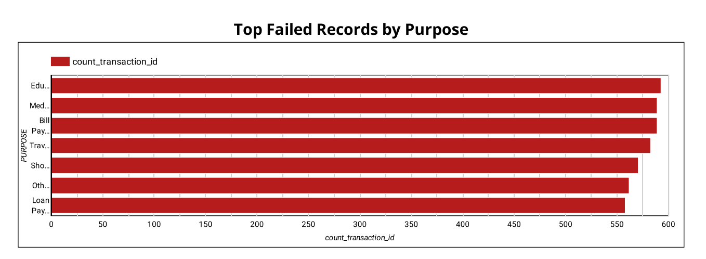
outputs

Slide 11
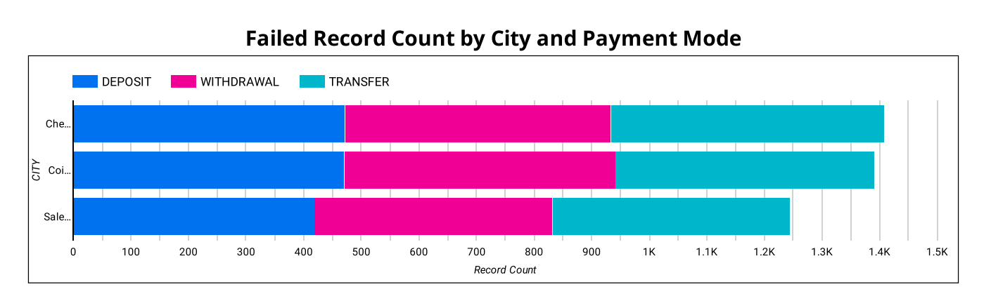
outputs

Slide 12
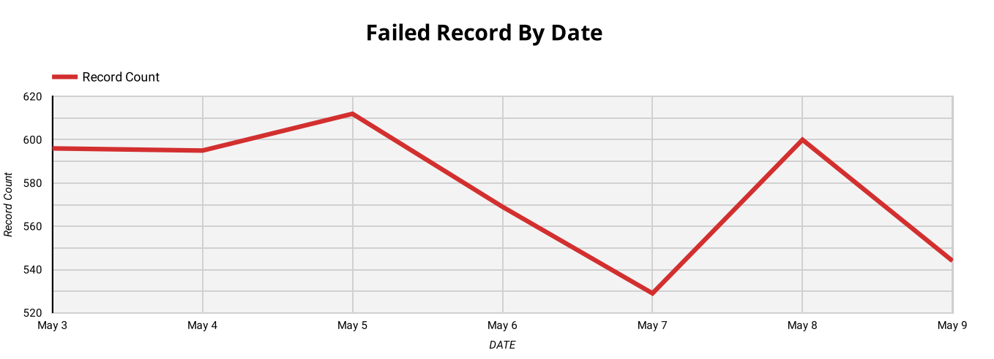
outputs

Slide 13
conclusion
This project successfully demonstrates a scalable pipeline to identify and analyse failed bank transactions.
Using PySpark, the raw data cleaned and filtered large datasets, ensuring only relevant failure records were stored in the Cloud SQL.
Data was ingested into Cloud SQL, enabling structured storage and seamless querying through BigQuery for analysis and visualizations.

